Slide 1
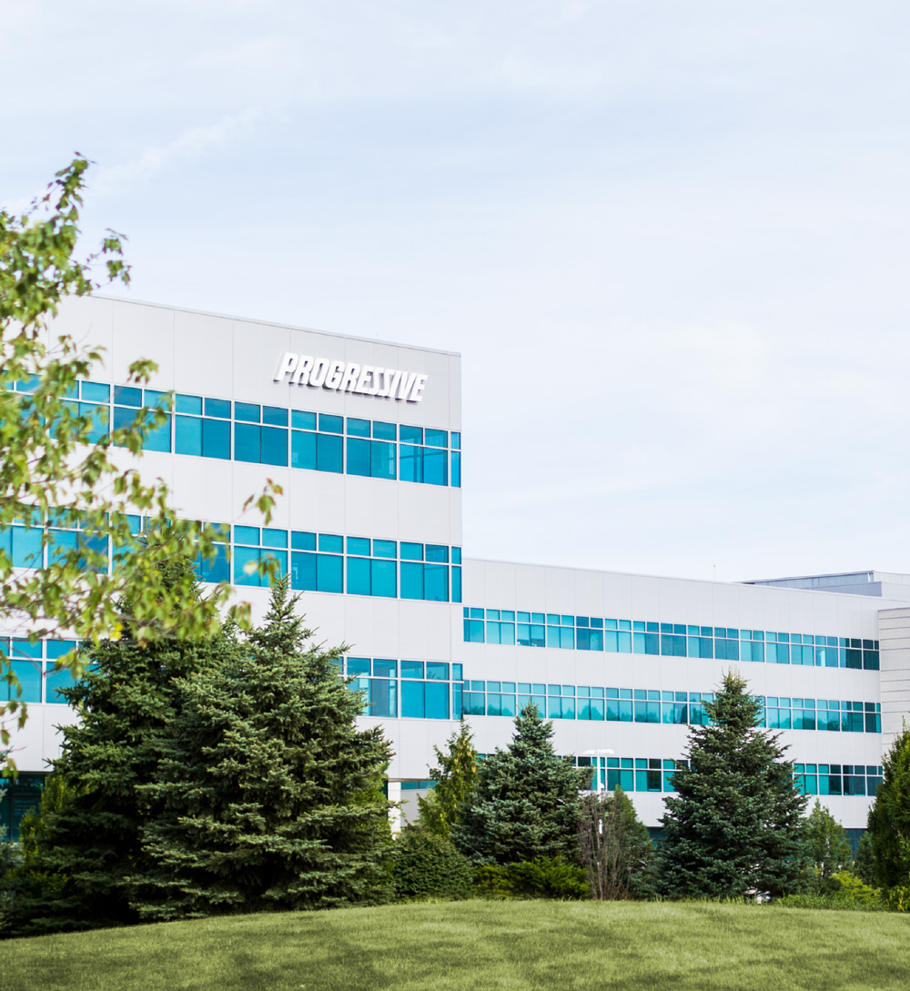

Analyst
Boot Camp
Group Project
April 2024

Slide 2
Agenda
01 | Introductions
02 | Project Goals
03 | Project Background & Data
04 | Project Schedule
05 | Guest Speaker
06 | Closing
2

Slide 3
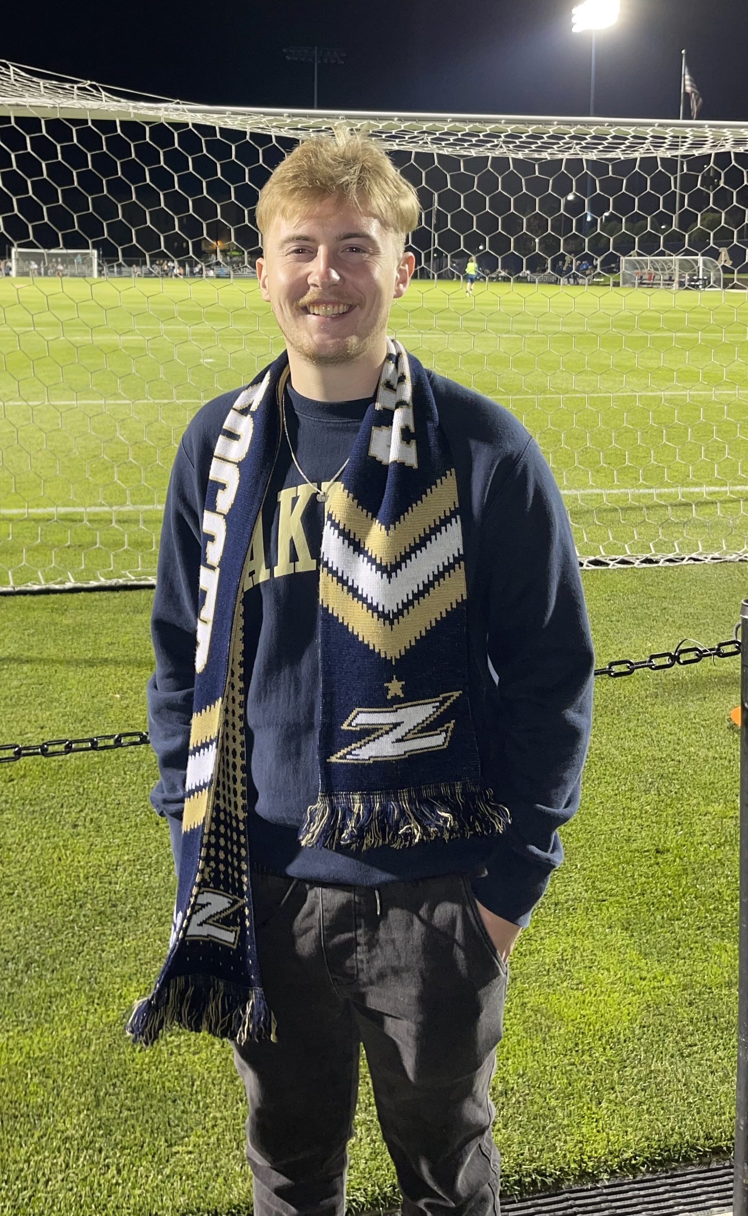






Xavier Zup
ADP Rotational Analyst II, Personal Lines Control
ABC Project Sponsor

Slide 4

Progressive Journey
Graduated from Ohio University (Finance & Business Analytics)
Joined the ADP as an intern in Summer 2022 (Corporate Finance)
Rotation #1: DPAX PL Acquisition
Rotation # 2: CL Product Control
For Fun
Working out
Fishing
Watching sports (Football & Basketball)
Watching podcasts + Reading
Playing Video Games

Slide 5

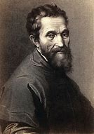
Section
02
The greater danger for most of us lies not in setting our aim too high and falling short, but in setting our aim too low and achieving our mark.
Project Goals
Michelangelo
Italian Renaissance Artist
5

Slide 6
Project Goals
1.
2.
3.
Business Strategy
Engages in comprehensive discussions with various stakeholders to understand and translate project goals into actionable strategies, ensuring alignment with competition objective.
Technical Skills
Employs advanced technical expertise in developing analytical programs using tools like Excel, SQL and Tableau, alongside proficient data retrieval, verification, and presentation techniques to support complex business analysis requirements.
Analytical Creativity
Leverages analytical creativity to compile, forecast, and interpret data trends, recommending innovative solutions and process improvements to stakeholders, and leading complex projects beyond one's own business area.
6

Slide 7
Look Familiar?
These Goals Align with Data Analyst III Roles
Click here -> Job Profile
Search “Data Analyst”
7

Slide 8
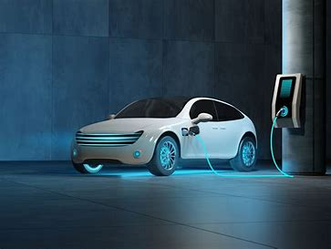
Section
03
Project Background and Data
8

Slide 9


Start Your Engines!
Project Background
These datasets revolves around Electric Vehicles
Data Sets
Parameters
InVIZtational
Fuel Station Data
2022 Light-Duty Vehicle Registration Counts by State and Fuel Type
You will have 2 weeks to use any Progressive-approved tools of your choice to build a visualization, which will be judged on analysis, design, and storytelling.
You need to use at least one of the data sets.
Feel Free to join any other relevant data.
This project is inspired from the yearly competition Progressive hosts through the Analyst Professional Group (APG).
Progressive InVIZtational (sharepoint.com)
9

Slide 10
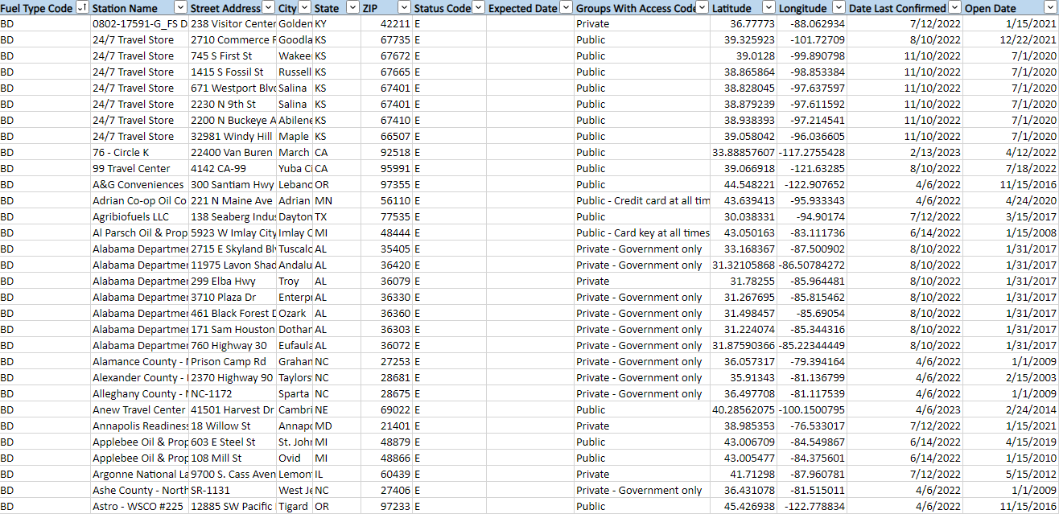

Data Set 1
Fuel Station Data
Link:
Fuel Station Data
Source: Source information can go here in this area
10

Slide 11
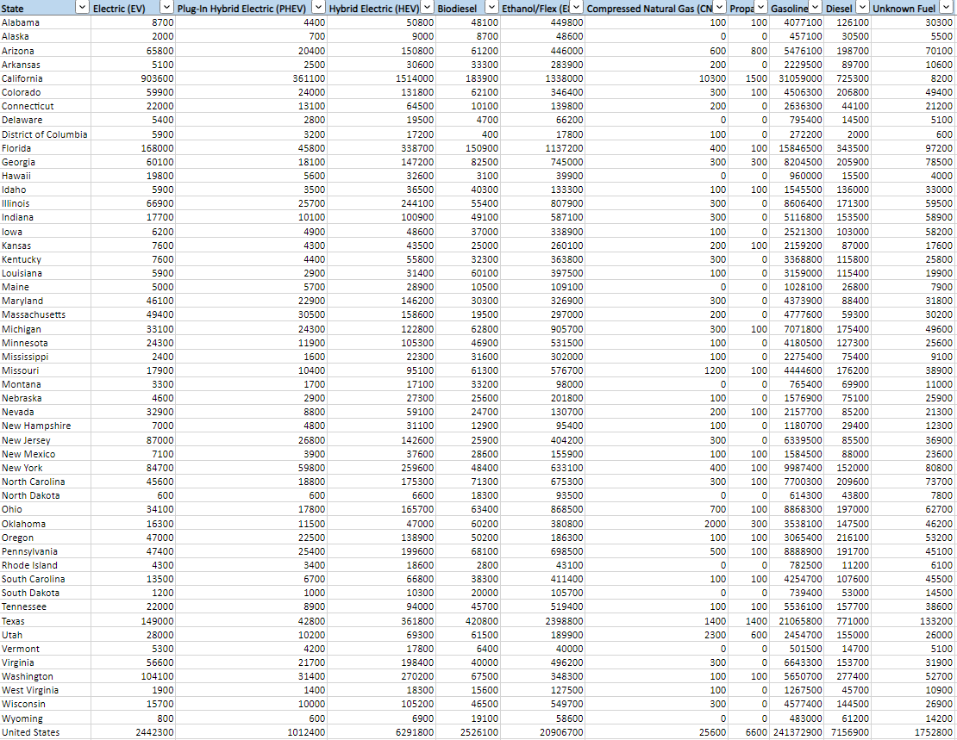
Data Set 2
2022 Light-Duty Vehicle Registration Counts by State and Fuel Type
Link:
2022 Light-Duty Vehicle Registration Counts by State and Fuel Type
Source: Source information can go here in this area
11

Slide 12

Section
04
Project Schedule
12

Slide 13
Estimated Timeline
Day 1
Project Kick-off, Dataset Exploration, and Guest Speaker
Day 5
Visualization
and Guest Speaker
Day 9
Final Touches
and Check-in: Four
Day 3
Data Preparation
Day 7
Dashboard Creation
Apr 8 | Apr 9 | Apr 10 | Apr 11 | Apr 12 | Apr 15 | Apr 16 | Apr 17 | Apr 18 | Apr 19
Day 2
Initial Analysis
and Check-in: One
Day 4
Data Preparation Continued
and Check-in: Two
Day 6
Visualization Continued
and Check-in: Three
Day 8
Presentation
and Guest Speaker
Day 10
Final Presentations
with Special Judges
13

Slide 14

Section
05
Guest Speakers
14

Slide 15

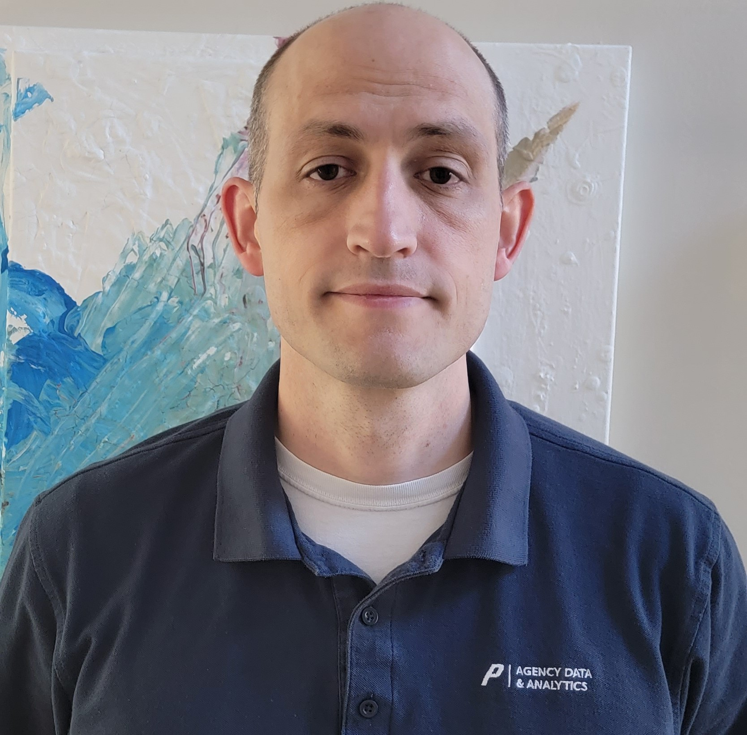

Derek Fazulak
Trevor Harkreader
Danny Reyes
Data Analyst 3
Data Analyst 3
Data Analyst 3

Slide 16
Agenda
01 | Data gathering
02 | Prepping the data
03 | Identifying visuals for our VIZ
04 | Final VIZ
05 | Q&A
16

Slide 17

Had a brainstorming session on what other additional information could be FUN to include to support the provided data.
Each of us focused on different items that we thought would be interesting. Making sure we aligned on a story.
As a team we decided to focus on overall story for our VIZ. Remember, as team you need to have ONE voice.
Things to think about
Be Curious.
Find something YOU find interesting.
Ask yourself, “How would this fit in to the overall VIZ”.
Less is more, keep it simple and straightforward.
Think about easily accessible data.
Ex. (U.S. Population, Gas Prices)
Section
01
Data Gathering
17

Slide 18

Since the data provided was in Excel, we decided to use that tool to prep our data.
We “cleaned” up some items we thought were not needed to support our story or weren’t significant for us to include.
Ex. Hawaii, Alaska
Things to think about
Is this data Tableau/Power BI ready?
Does anything look weird? QA
Clean any data rows or columns
Section
02
Prepping the Data
18

Slide 19

As a team, we identified all our strengths and weaknesses.
Ex. Tableau User Vs. Power Bi or Other
We were able to differentiate this looks “Cool” Vs. “This visual supports our analysis and looks Cool”.
Added meaningful visuals.
Ex. Charging Station Map
Looked for visuals that did not need a lot of explanation and spoke for themselves or a user could quickly grasp or understand.
Things to think about
Look at Tableau Public for Ideas. https://public.tableau.com/app/discover
Keep it clean and organized.
Design for Accessibility.
Choose inviting colors and use the same font across the board.
Section
03
Identifying Visuals for our VIZ
19

Slide 20
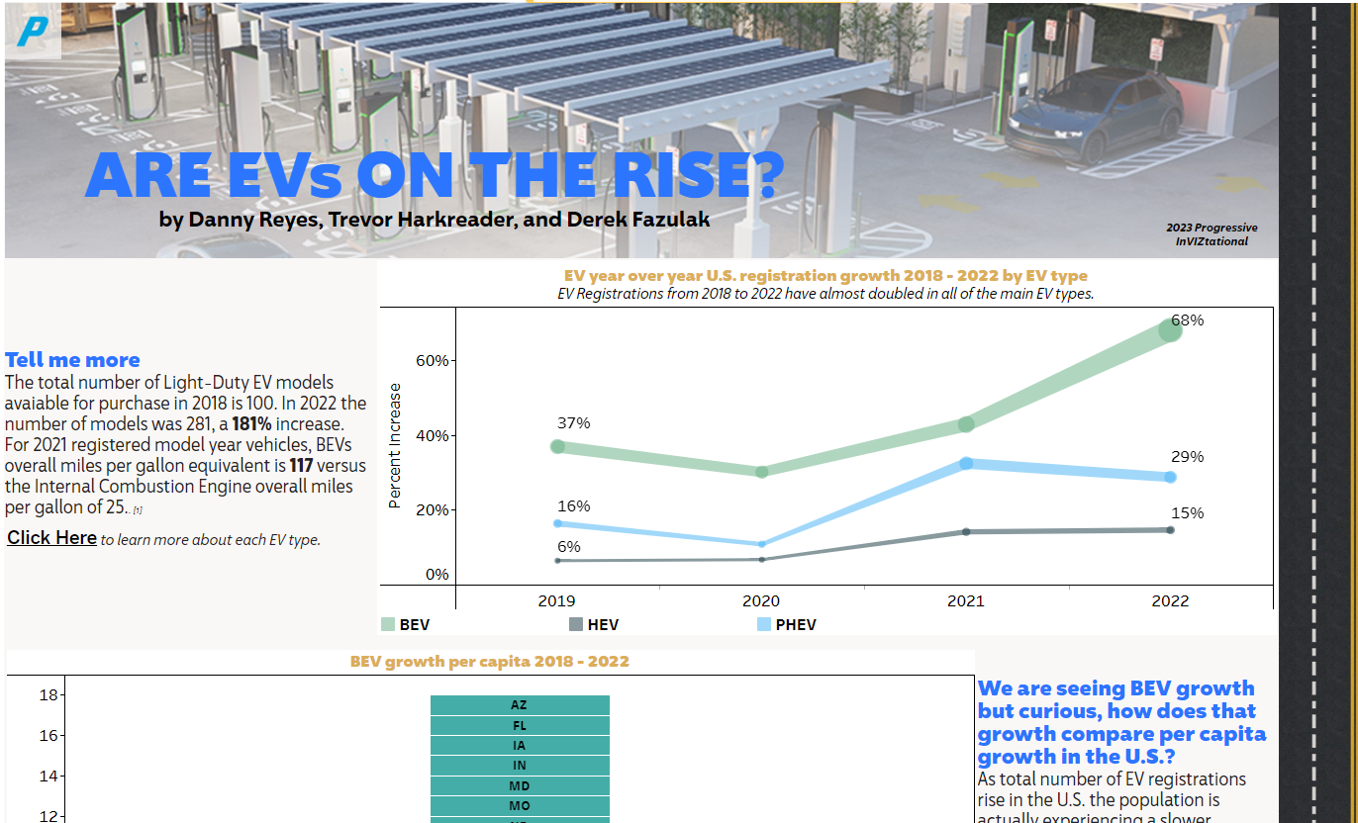
Final Submission
Section
04
Final VIZ
20

Slide 21

Q&A
21

Slide 22
Thank You!
22

